Slide 1



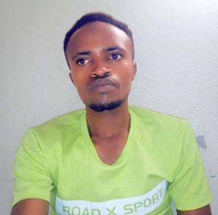
Contact Us
Help
About us
Publication
Home
Help
Web shop

Slide 2
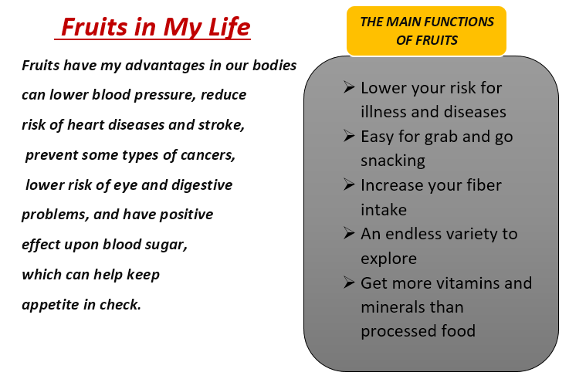
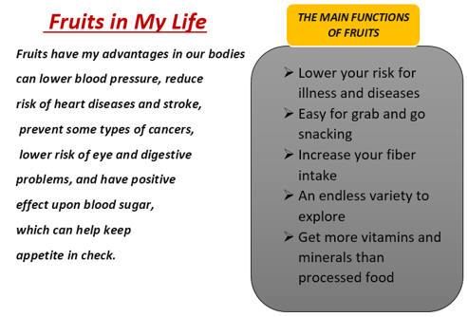
FRESH FRUITS WEB SHOP WE SELL ALL KINDS OF FRUITS THAT YOU KNOW
AT VERY LOW COST AND FREE OF DERIVERYING

Slide 3
FRESH FRUITS WEB SHOP WE SELL ALL KINDS OF FRUITS THAT YOU KNOW
AT VERY LOW COST AND FREE OF DERIVERYING
FRESH FRUITS WEB SHOP WE SELL ALL KINDS OF FRUITS THAT YOU KNOW
AT VERY LOW COST AND FREE OF DERIVERYING
IF
YOU HAVE
ANY PROBLEM
ABOUT TO OFFER THE
FRUITS OR SYSTEMS FUNCTIONALITIES
PLEASE CALL THE SYSTEM ADMINISTRATOR
ON
0782192851

Slide 4
OUR VISSION
To sell perfect quality of fruits
To work 24 hours in 7 days
To reach you in your local villages
To expand our system
OUR PATTERNERS
MTN
Bank of Kigali
Rwanda Polytechnic
Rwandair
B&B Umwezi FM
City Radio
OUR MISSION
The stem development will be expanded beyond the country And All of these services will be monetarized more efficient

Slide 5
THE
SYSTEM IS
BEING MAINTAINED
PLEASE CLICK HELP BUTTON FOR MORE CONTACT, DETAILS AND HELP

